Slide 1
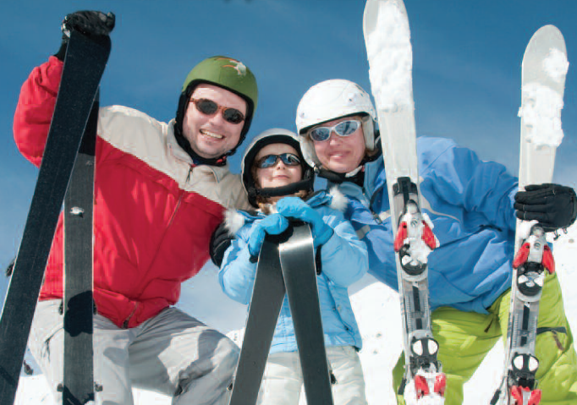
2017 NYSCC SKI TRIP
February 24th 2017
Hunter Mountain, NY
Pricing (SCC members and not):
Adult lift ticket (19 and up) $42
Youth lift ticket(7-18) $40
Ski rental $29
Snow Board Rental $29
Beginners lesson Pack $49
All America Buffet Lunch $30
(main lodge)
Recommended Lodging:
Hampton Inn Kingston (www.kingston.hamptoninn.com tel: 845 382 2600) Special rate for NYSCC SKI TRIP
Feb 23rd and 24th: $119/night plus tax
Please book latest by Jan 20th
Speaker (12:00-12:20 over lunch)
Marc Cornell – VP Product Development Englewood Laboratories
Topic: Skin Biochemistry
This is a family event so kids and other invited guests are welcome.
Registration available at NYSCC website www.nyscc.org
Car pooling is recommended: persons seeking ride sharing opportunities please contact Gita Calton (gita.calton@aak.com, mob: 732 713 3416)
Questions/info refer to: Joe Albanese (joe@sytheonltd.com, mob: 908 456 2968)
Pasquale Aramo (p.aramo@3VSigmaUSA.com, mob: 862 621 50 22)
Special Events Chair 2017: Amy Marshall (amy.marshall@altana.com,mob: 908 391-6294)

